Slide 1
Let Me Know What to Ask: Interrogative-Word-Aware Question Generation
ADVISOR:JIA-LING KOH
SOURCE:EMNLP 19
SPEAKER:LI-WEI LiU
DATA:2020/03/23

Slide 2
OUTLINE
Introduction
Method
Experiment
Conclusion

Slide 3
INTRODUCTION
Question Generation (QG):
Passage(P): Mr. Huang's favorite dog was lost yesterday
Answer(A): yesterday
Input P & A
Generated question
Question: When was Mr. Huang's favorite dog lost?
Interrogative word is correct or not greatly affects the subsequent sentence generation
Notes:
傳統的QG

Slide 4
INTRODUCTION
Goal:
Improve the accuracy of interrogative word generation to generate questions
The interrogative word classification task is easier to solve than generating the interrogative word along with the full question in the QG model
Interrogative-Word-Aware Question Generation(IWAQG)
Notes:
使用interrogative word classification (分類任務) 比一般的decoder較簡單解決生成疑問詞這個問題

Slide 5
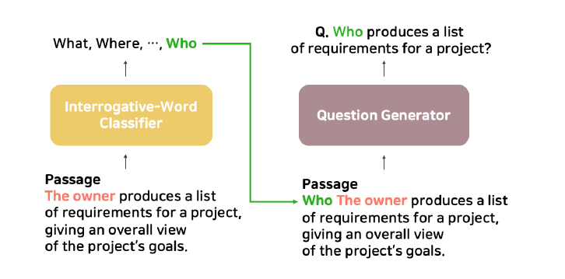
INTRODUCTION
Separating two tasks
Interrogative-Word-Aware Question Generation(IWAQG)
Input:
a passage P,
and an answer A
Output:
the interrogative word I_{w}
Input:
P , A , I_{w}
Output:
a question Q

Slide 6
OUTLINE
Introduction
Method
Experiment
Conclusion

Slide 7
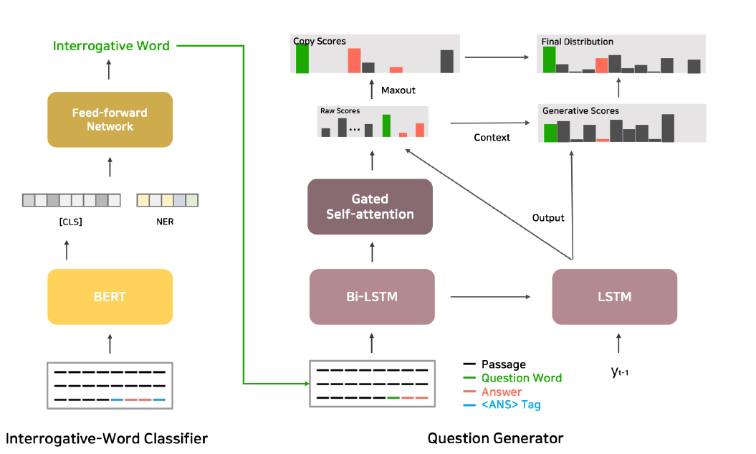
FRAMEWORK

Slide 8
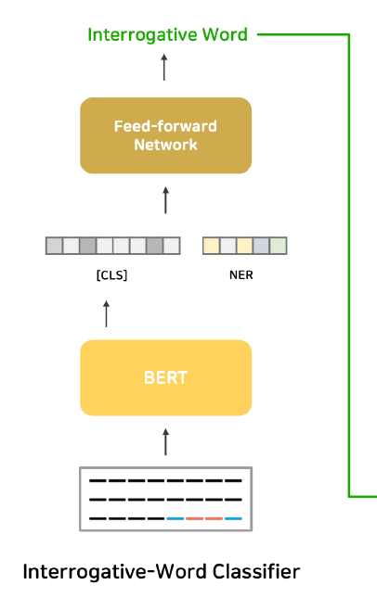
METHOD
Interrogative-Word Classifier
Concated
Input:
Mr. Huang's favorite dog was lost yesterday [ANS]yesterday[ANS]
Use BERT to predict I_{w}
Transform token:
[CLS] Mr. Huang's favorite dog was lost yesterday [SEP] [ANS] yesterday [ANS]

Slide 9
METHOD
Interrogative-Word Classifier
[CLS]:
Output dimension is 8
since we predict the interrogative words:
what, which,where, when, who, why, how, and others.
NER(Name Entity Recognition):
Output dimension is 5
Ex: yesterday is date
Notes:
NER 命名實體識別
例如 Mr.Huang = person

Slide 10
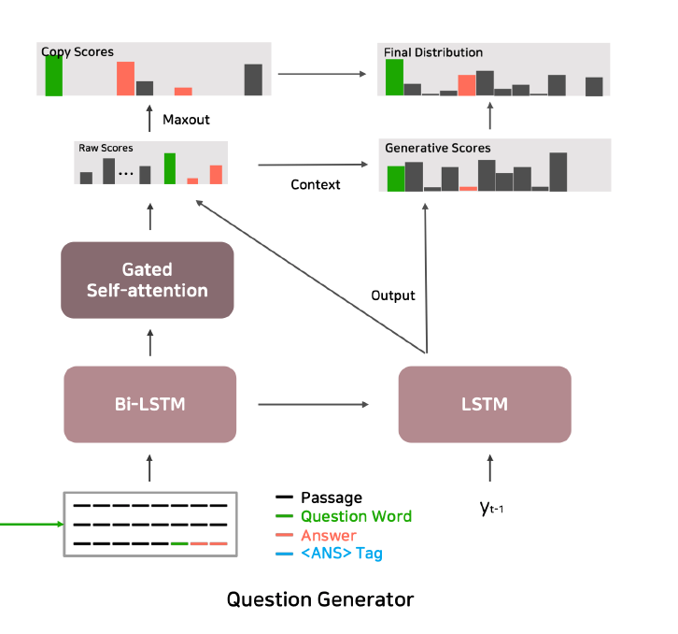
METHOD
Question Generator
Input:
Mr. Huang's favorite dog was lost yesterday When yesterday
Notes:
NER 命名實體識別
例如 Mr.Huang = person

Slide 11
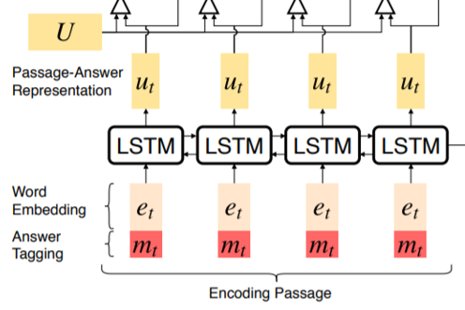
METHOD
Encoder
Bi-LSTM:
e_{t}: word embedding of word x_{t}
m_{t}: meta-word representation (whether word x_{t} is the answer)
u_{t}: passage-answer representation
Notes:
利用雙向LSTM 去計算整個passage與answer之間的訊息

Slide 12
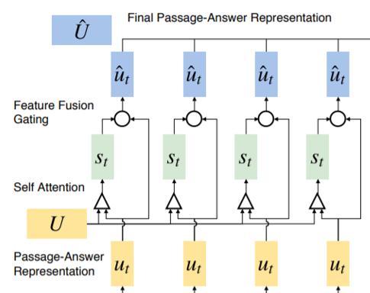
METHOD
Encoder
Gated Self-attention:
Encoded passage-answer representation
at every time step.
Compute self matching representation
s = {s_{t}}^{M}_{t=1} is the final self matching representation
Notes:
我們的Gated Self-attention旨在匯總整個段落中的信息，並嵌入段落內依存關係，以在每個時間步細分編碼的段落答案表示形式。
算出每個word的重要性(answer的重要性應該要較高)

Slide 13
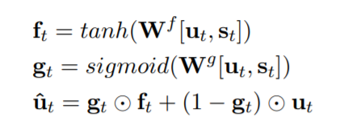
METHOD
Encoder
Gated Self-attention:
Combining the input with self matching representation using a feature fusion gate
Notes:
我們的Gated Self-attention旨在匯總整個段落中的信息，並嵌入段落內依存關係，以在每個時間步細分編碼的段落答案表示形式。
element-wise multiplication

Slide 14
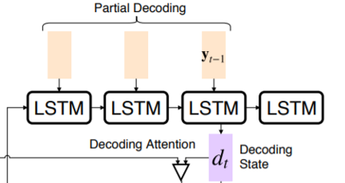
METHOD
Decoder
LSTM:
Generates words sequentially
d_{t}: represents the hidden state of the RNN at time t
At t = 0, it receives the last hidden state of the encoder
y_{t-1}:word generated at time t-1

Slide 15
METHOD
Decoder
Raw Scores:
Raw attention scores(Use attention layer)
Generative Scores:
Concatenation of decoder state d_{t} and the attention context vector c_{t}
Notes:
Generative Scores:
Concatenation of decoder state d_{t} and the attention context vector c_{t} 來計算新的分數

Slide 16
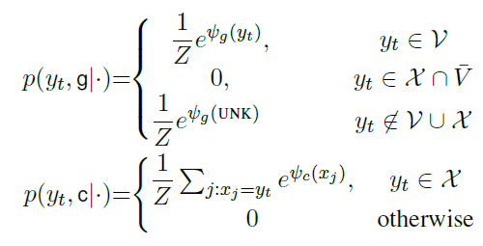
METHOD
Decoder
Copy Scores:
Mixture
two probabilities
Maxout :
(Avoid repeated word)
The score of a word at time step t is calculated as the maximum of all scores
Generate-Mode
V : vocabulary
X : another set of words(To copy)
may contain words not in V
Copy-Mode
Notes:
Pointing to the same word in the input sequence Pointer mechanism

Slide 17
METHOD
Decoder
Final probability distribution:
Each time step:
Concatenation of copy scores and generative scores
Softmax function

Slide 18
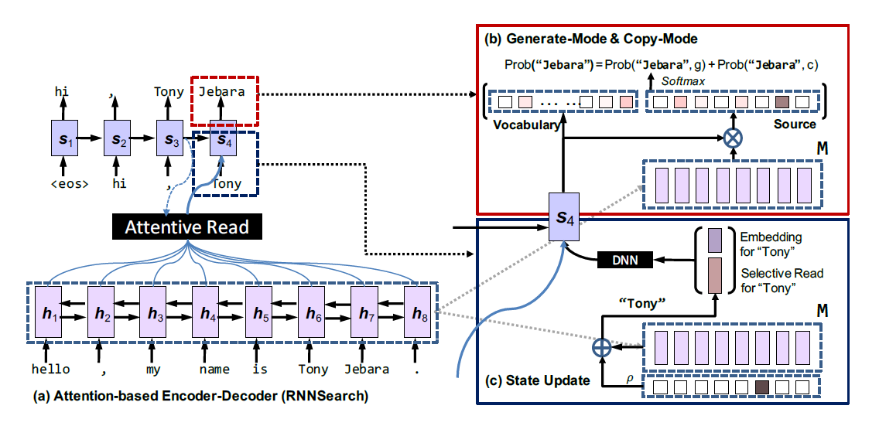
COPYNET

Slide 19
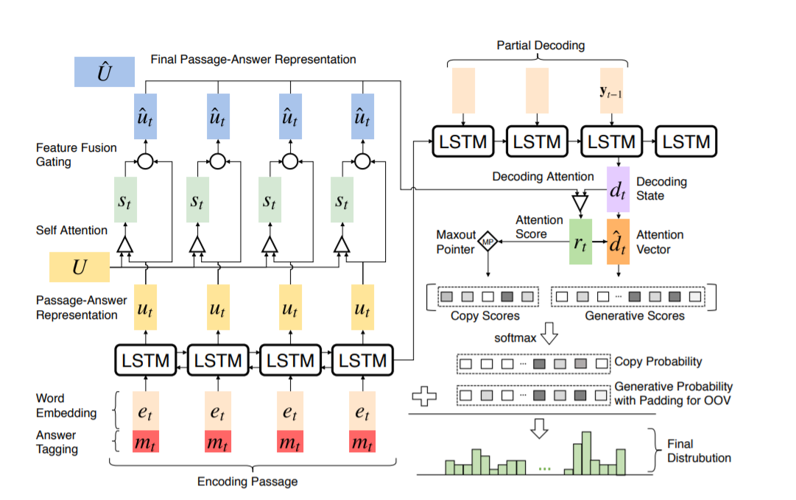
Paragraph-level Neural Question Generation with Maxout Pointer and Gated Self-attention Networks

Slide 20
OUTLINE
Introduction
Method
Experiment
Conclusion

Slide 21
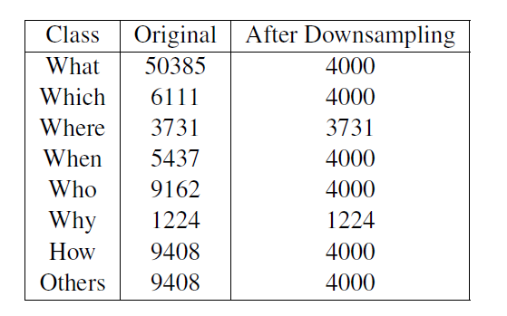
EXPERIMENT DataSets
Downsampling the training set to have a balanced dataset.(To train the interrogative-word classifier)
SQuAD v1.1
For QG model:
Training set: 86635
Dev set: 8965
Testing set: 8964

Slide 22
EXPERIMENT
Comparison with Previous Models
Notes:
Zhou et al. (2017) sequence-to-sequence model with attention and copy mechanism. Use POS and NER tags as lexical features for the encoder.
Zhao et al. (2018) Our QG model
Kim et al. (2019) Treats the passage and the target answer separately. (passage 用mask遮住ans ans也另外encoder)
Liu et al. (2019) Graph Convolutional Networks 貫宇之前報過的那篇

Slide 23
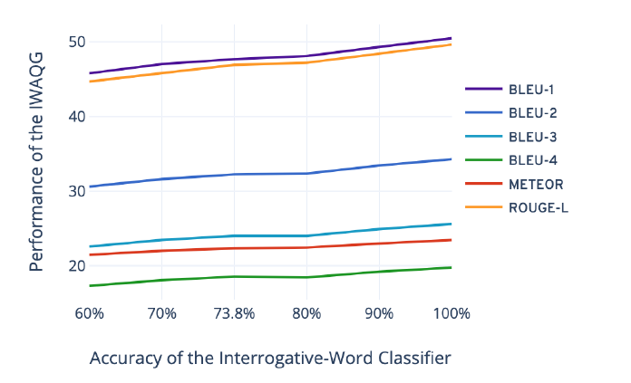
EXPERIMENT
Upper Bound Performance of IWAQG
Using the golden labels of the test set and generated noise to simulate a classifier with different accuracy levels.
Notes:
跟作者認為的 疑問詞的正確率會影響問題生成的準確率 的這個假設相符合

Slide 24
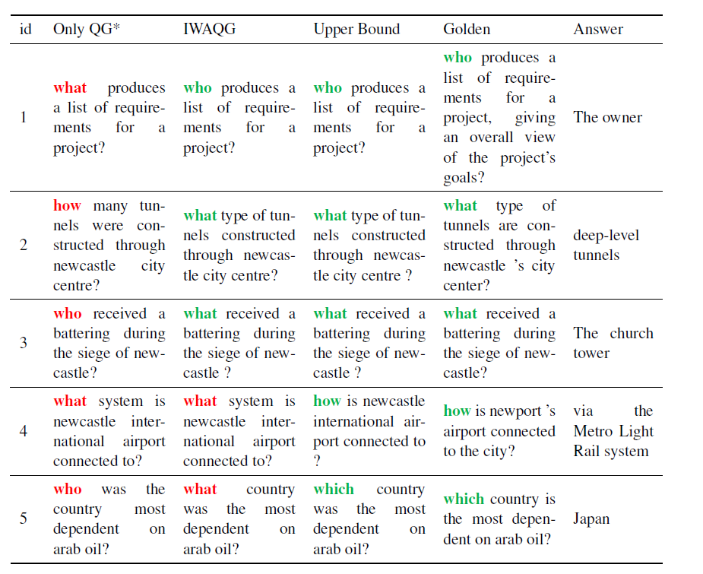
EXPERIMENT
If interrogative word classifier is good enough, QG generation can be more accurate
Notes:
Golden question:答案比問題本身所暗示的多

Slide 25
OUTLINE
Introduction
Method
Experiment
Conclusion

Slide 26
CONCLUSION
we proposed an Interrogative-Word-Aware Question Generation (IWAQG), with an independent interrogative-word classifier and the copy mechanism of the question generation model
Showing a theoretical upper bound of the potential improvement using a more accurate interrogative word classifier.
Notes:
1.獨立的疑問詞分類器可以更準確的生成疑問詞當作decoder的第一個字，加上使用copy mechanism 更好的生成問題句
2.使用更準確的疑問詞分類器顯現了潛在改善的理論上限。

